Slide 1

Unveiling Key Metrics for Audience Engagement and Revenue Generation
Tableau Dashboard – Group 3

Slide 2
Objective
Provide a comprehensive analysis of Audience Engagement and Revenue Performance
Uncover actionable insights to:
Enhance viewer interaction
Optimize monetization strategies

Slide 3
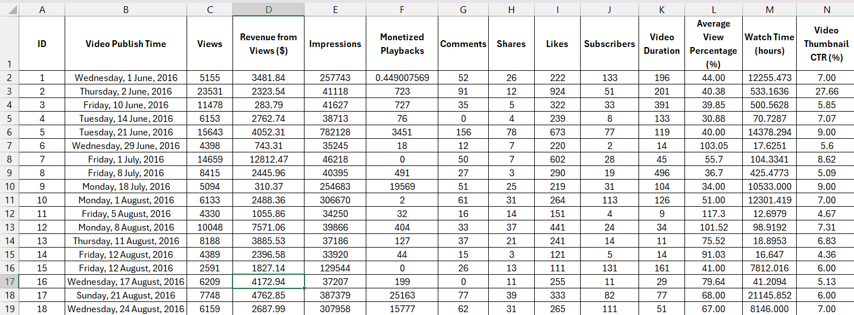
SNAPSHOT of data
Source: https://www.kaggle.com/datasets/positivealexey/youtube-channel-performance-analytics

Slide 4
Data Cleaning
Handling Missing Values
Correcting Data Types
Removing Outliers
Data Standardization
Adding Calculated Columns

Slide 5
pitch QUESTION
Which are the key drivers of YouTube video engagement and how do they influence revenue generation for different categories?

Slide 6
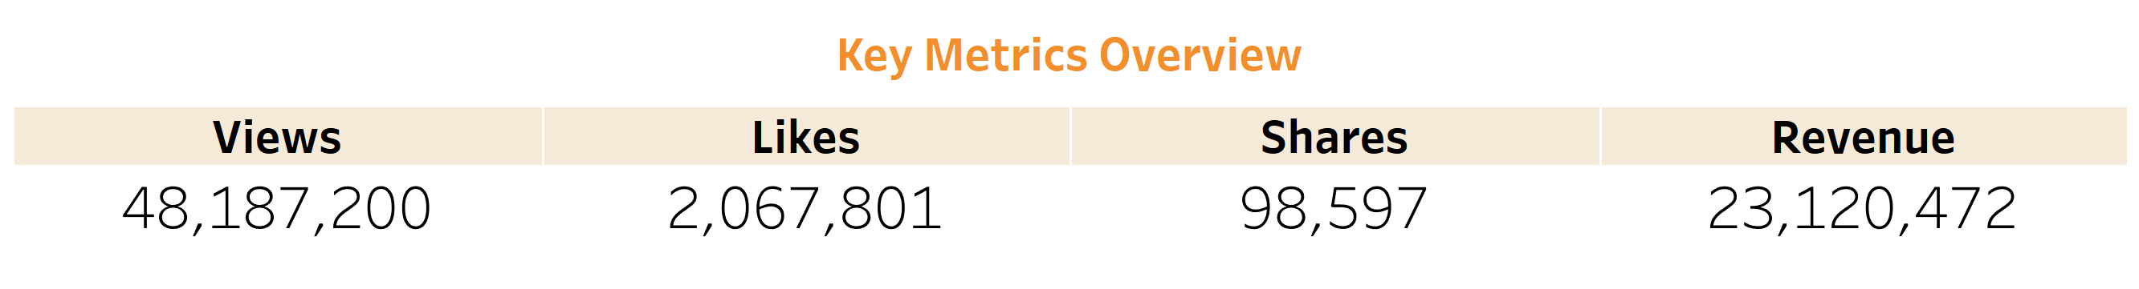
Summary of the dataset:

Slide 7
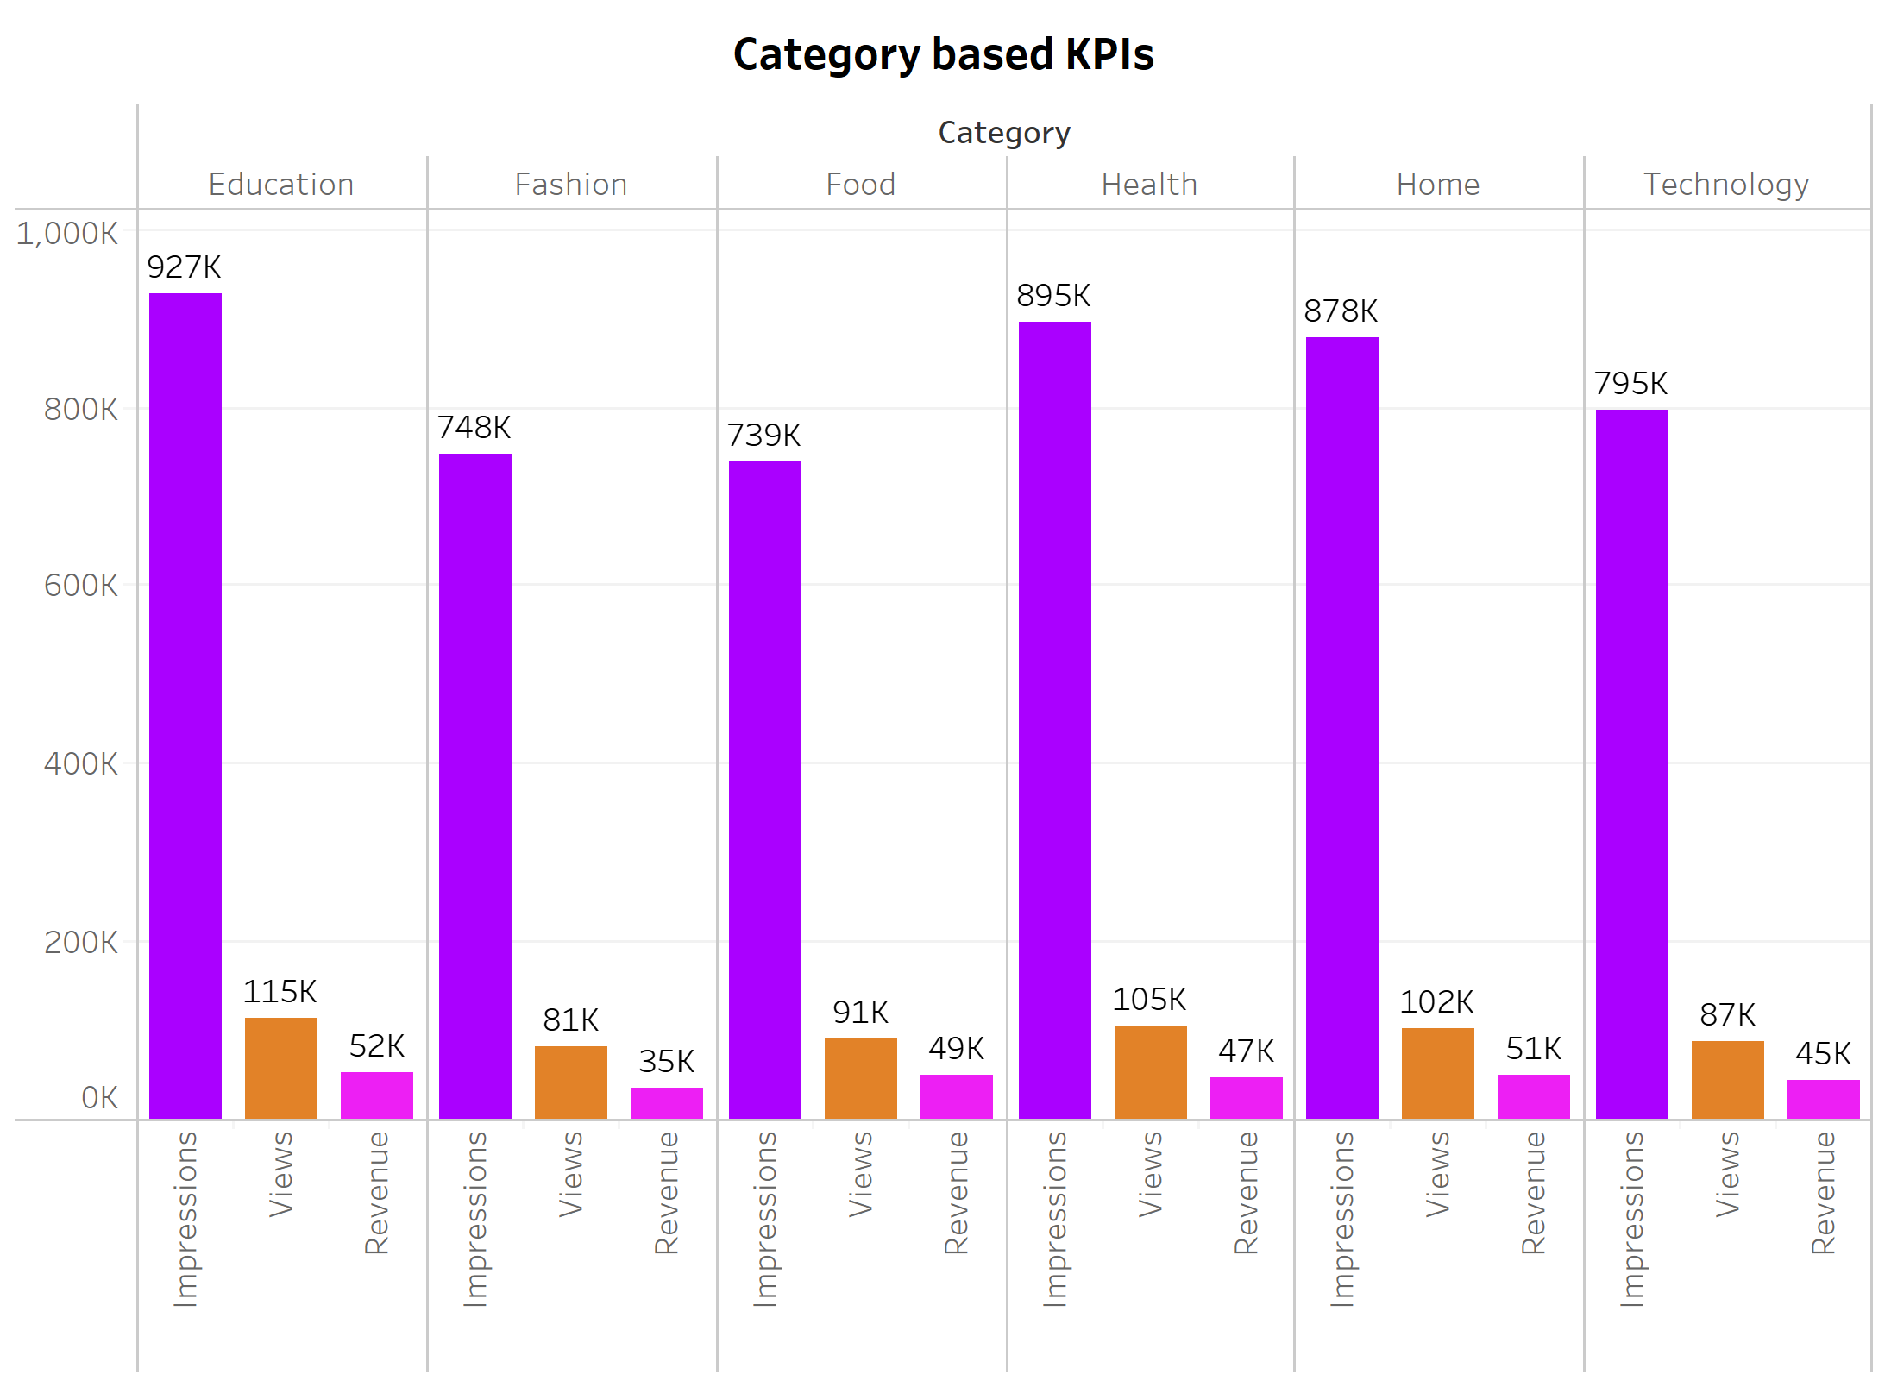
Category based KPIs
INSIGHT – 1:

Slide 8
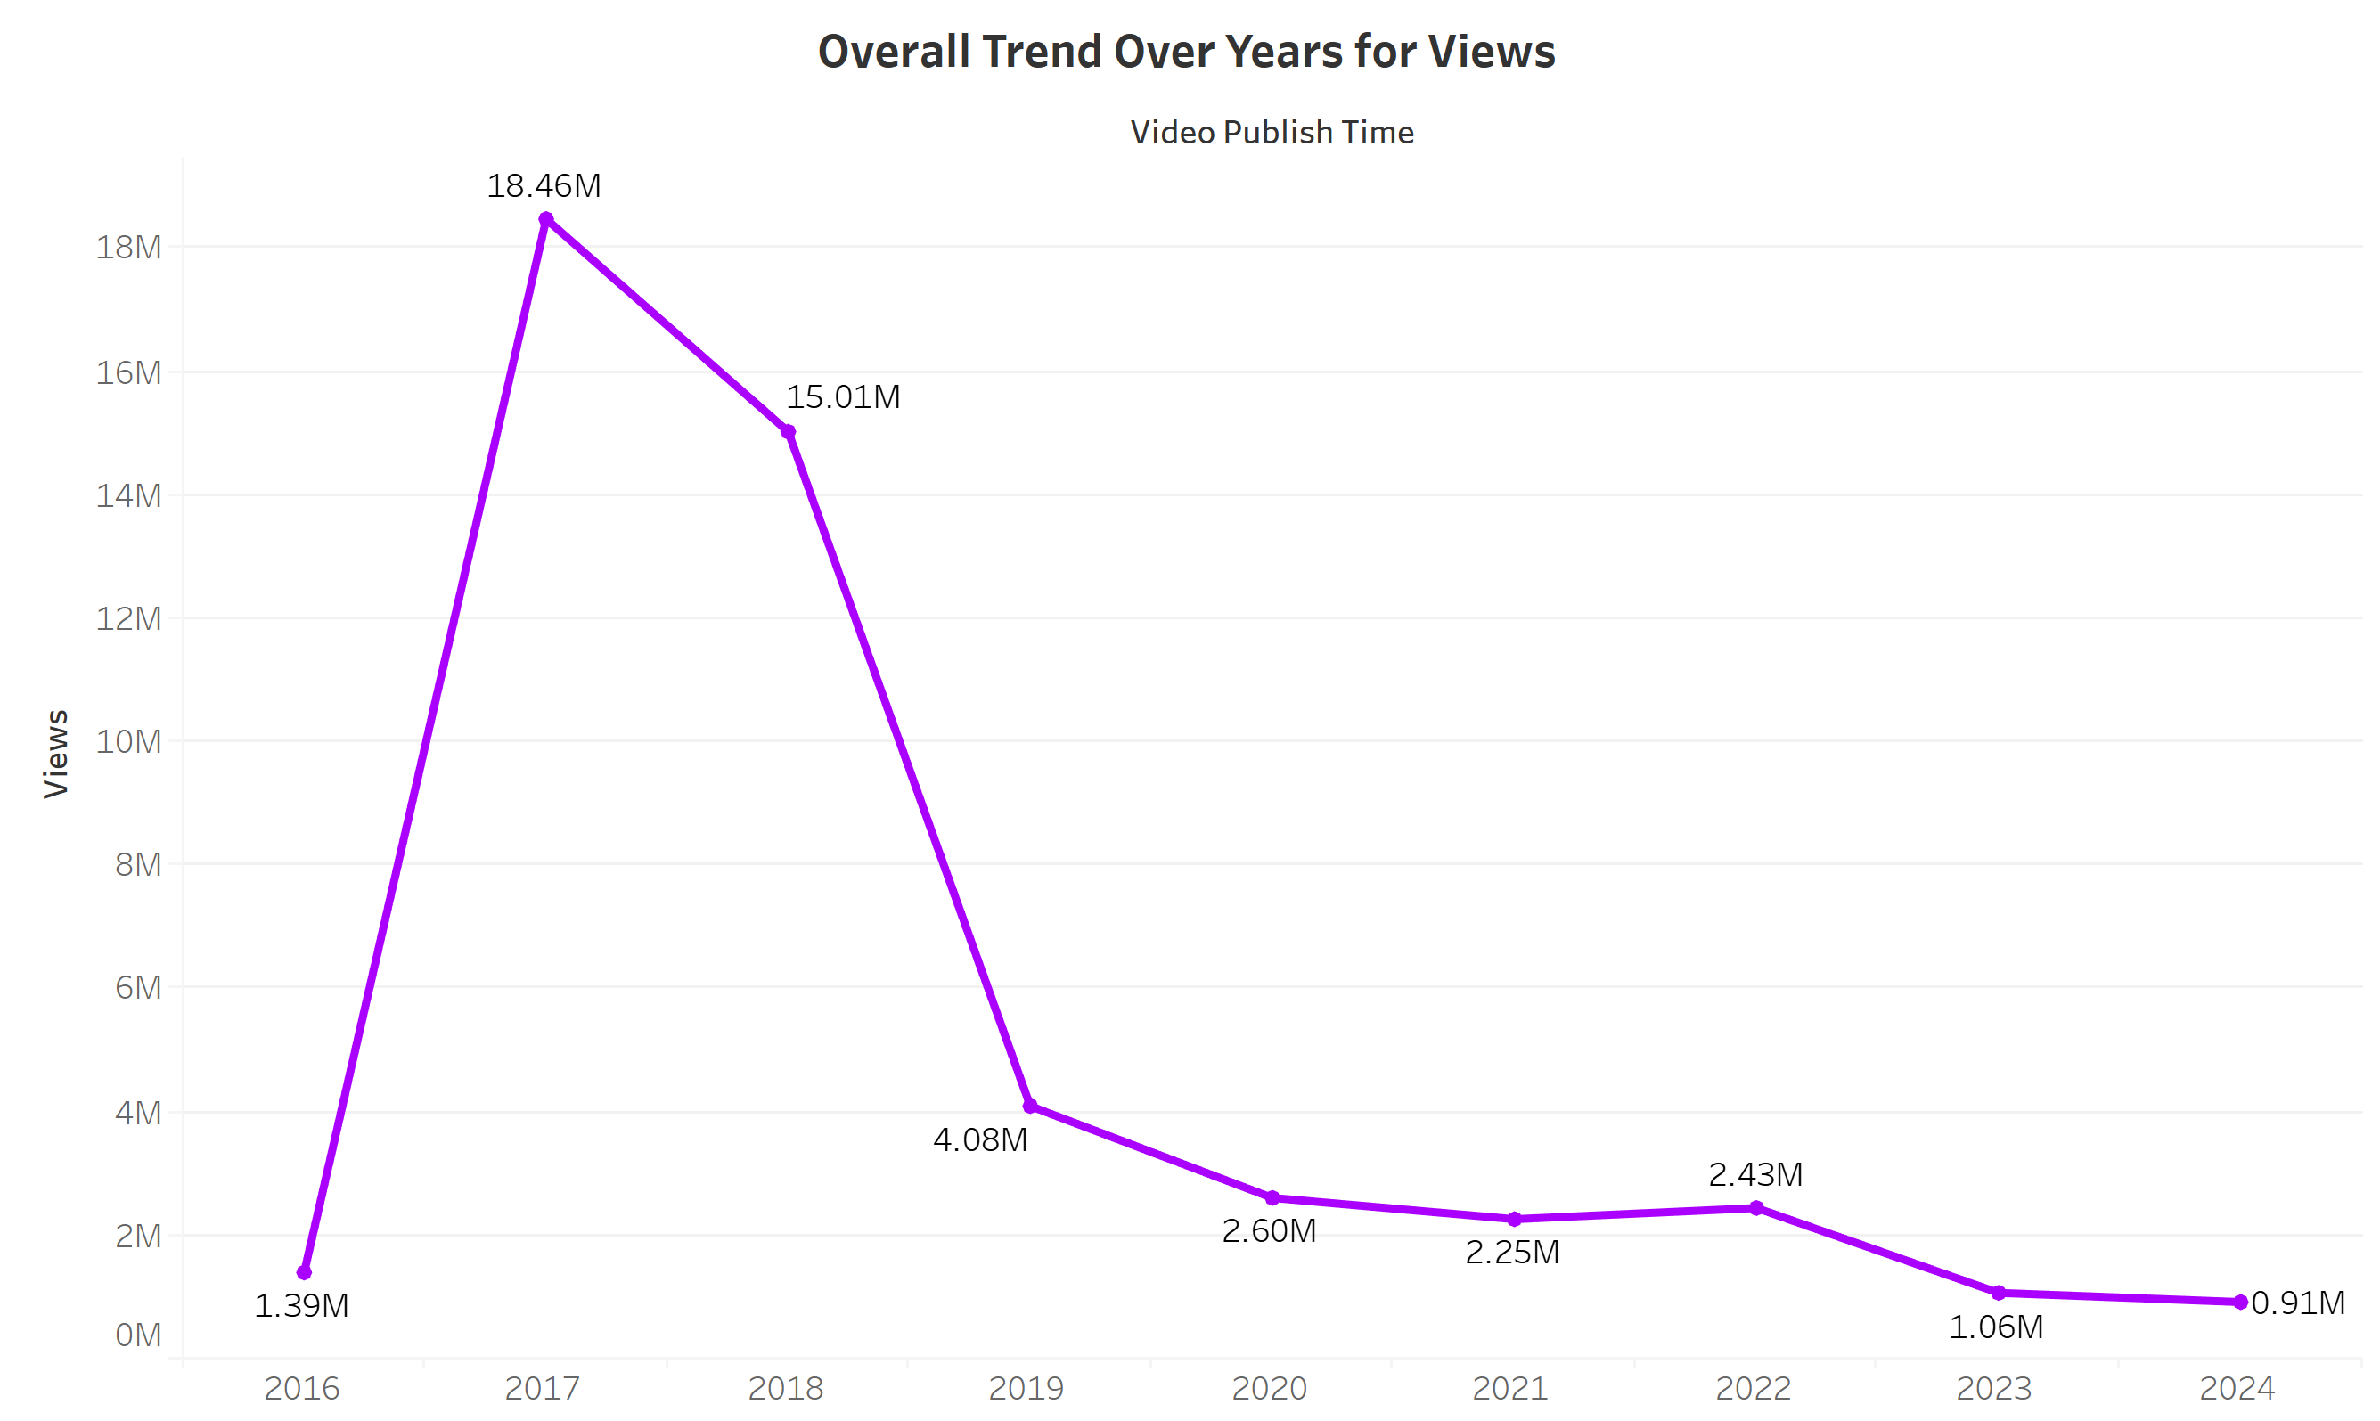
views on video trends over years
INSIGHT – 2:

Slide 9
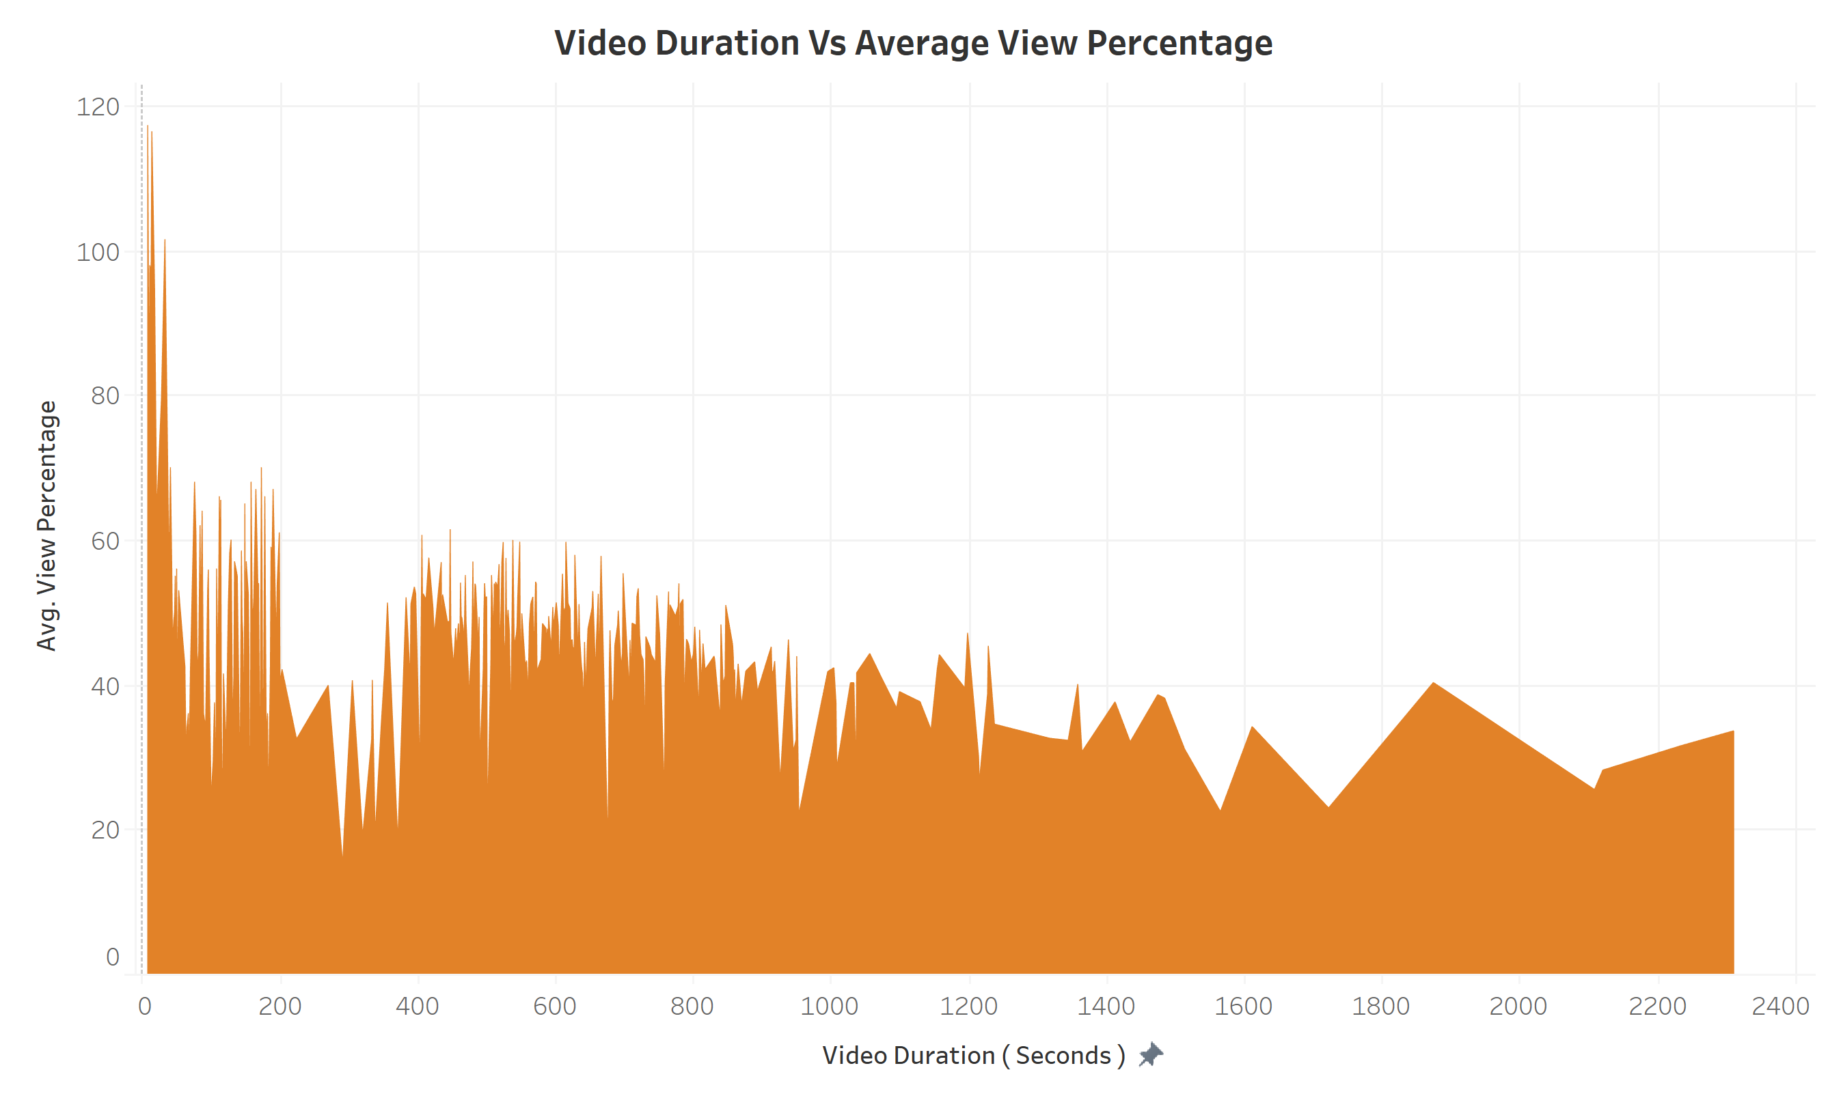
Correlation between avg view percentage with video duration?
INSIGHT – 3:

Slide 10
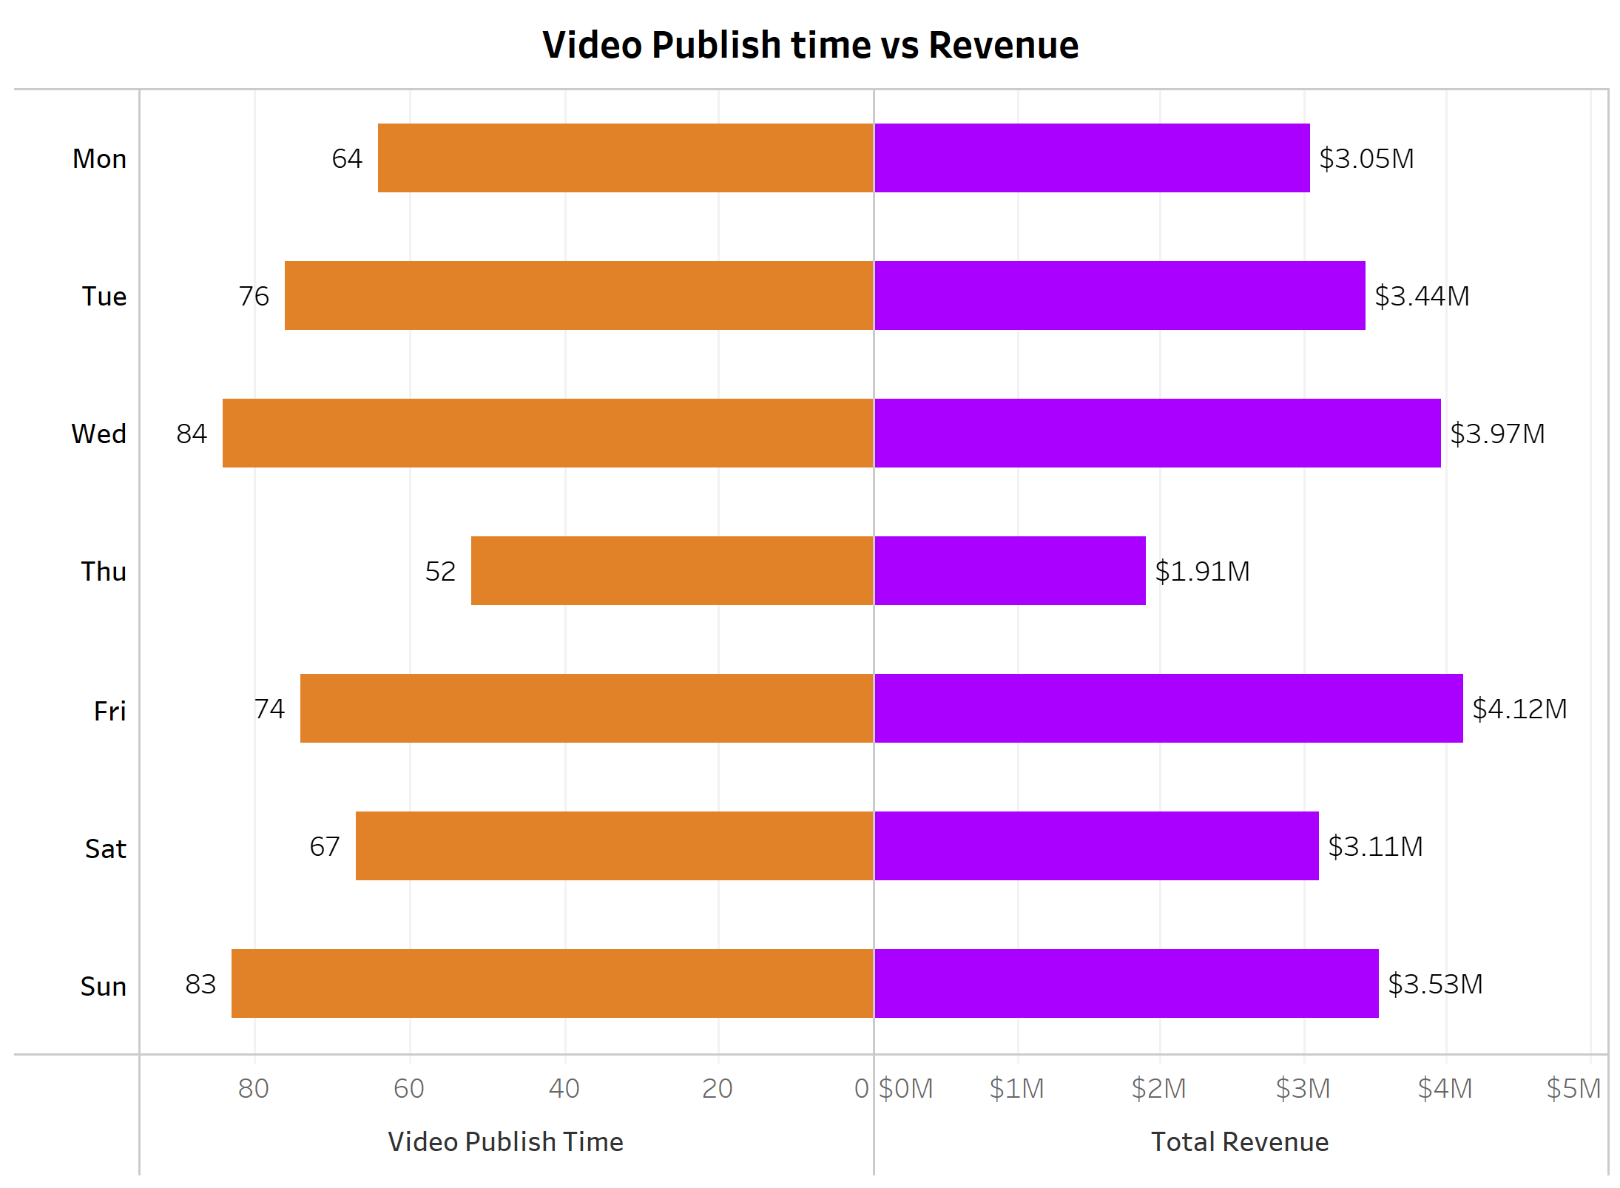
Days that bring most engagement and RevenuE
INSIGHT – 4:

Slide 11
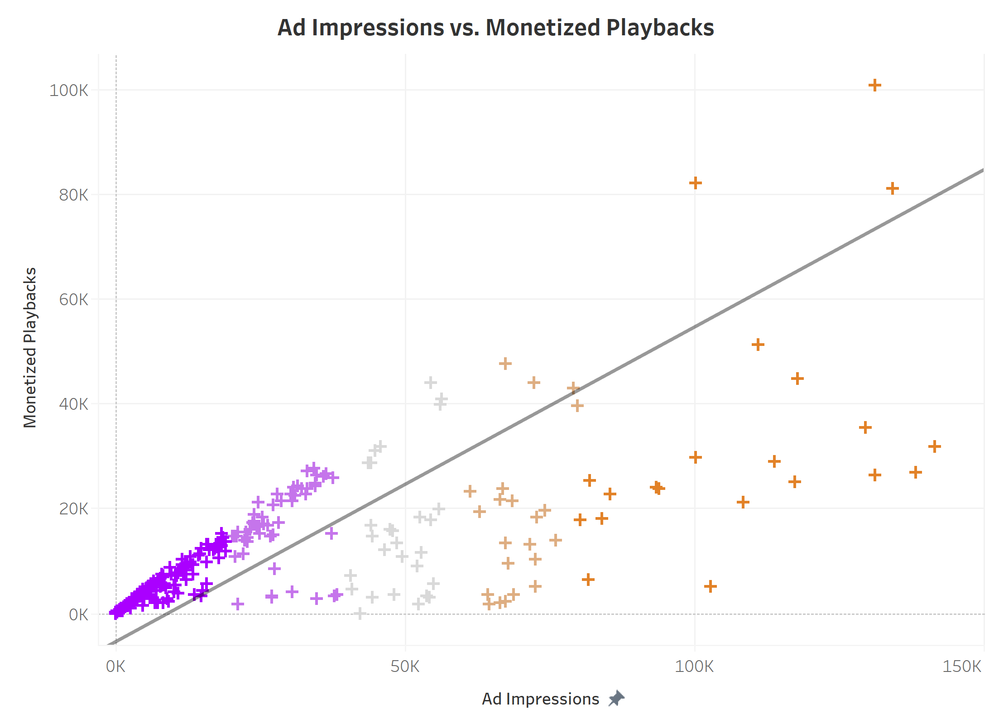
Influence of ad impressionsin revenue generation?
INSIGHT – 5:

Slide 12
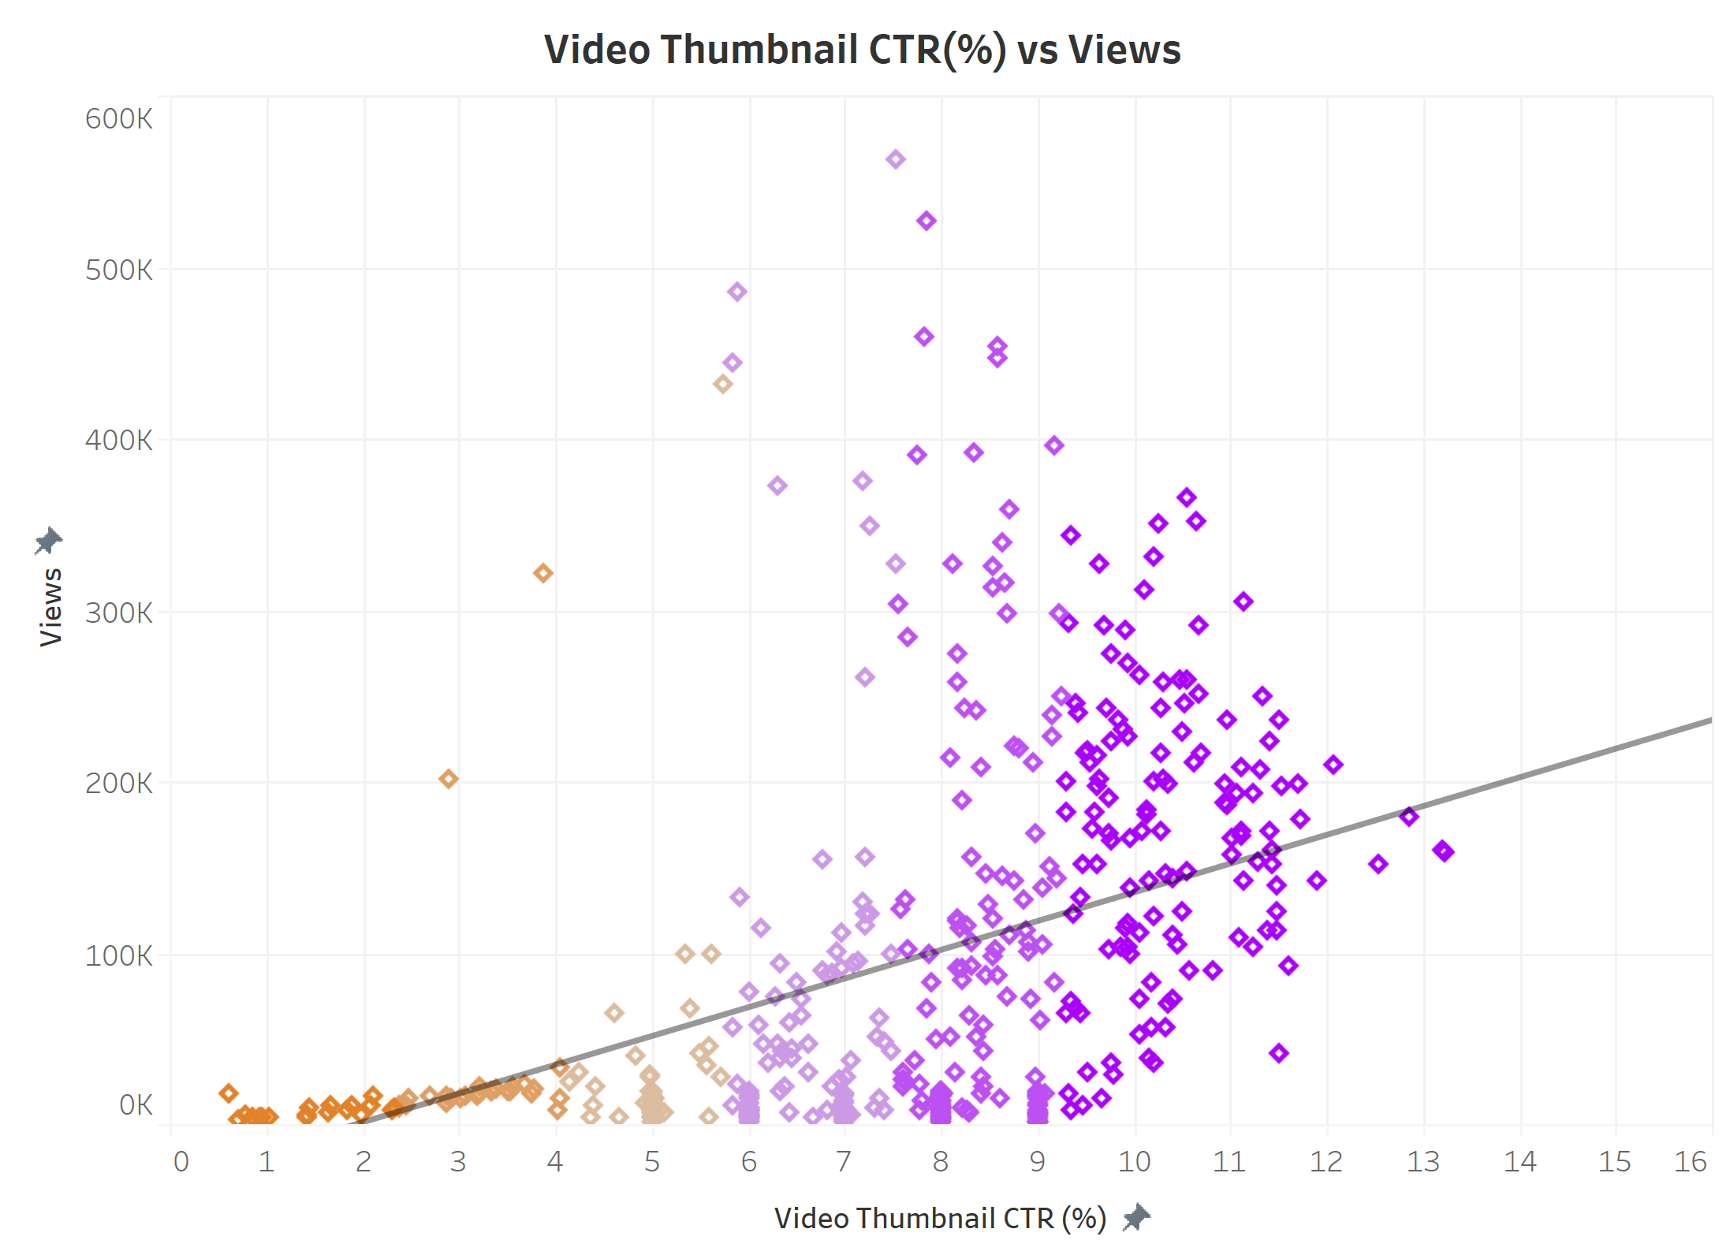
IMPACT OF click-through rate of video thumbnails oN Video views
INSIGHT – 6:

Slide 13
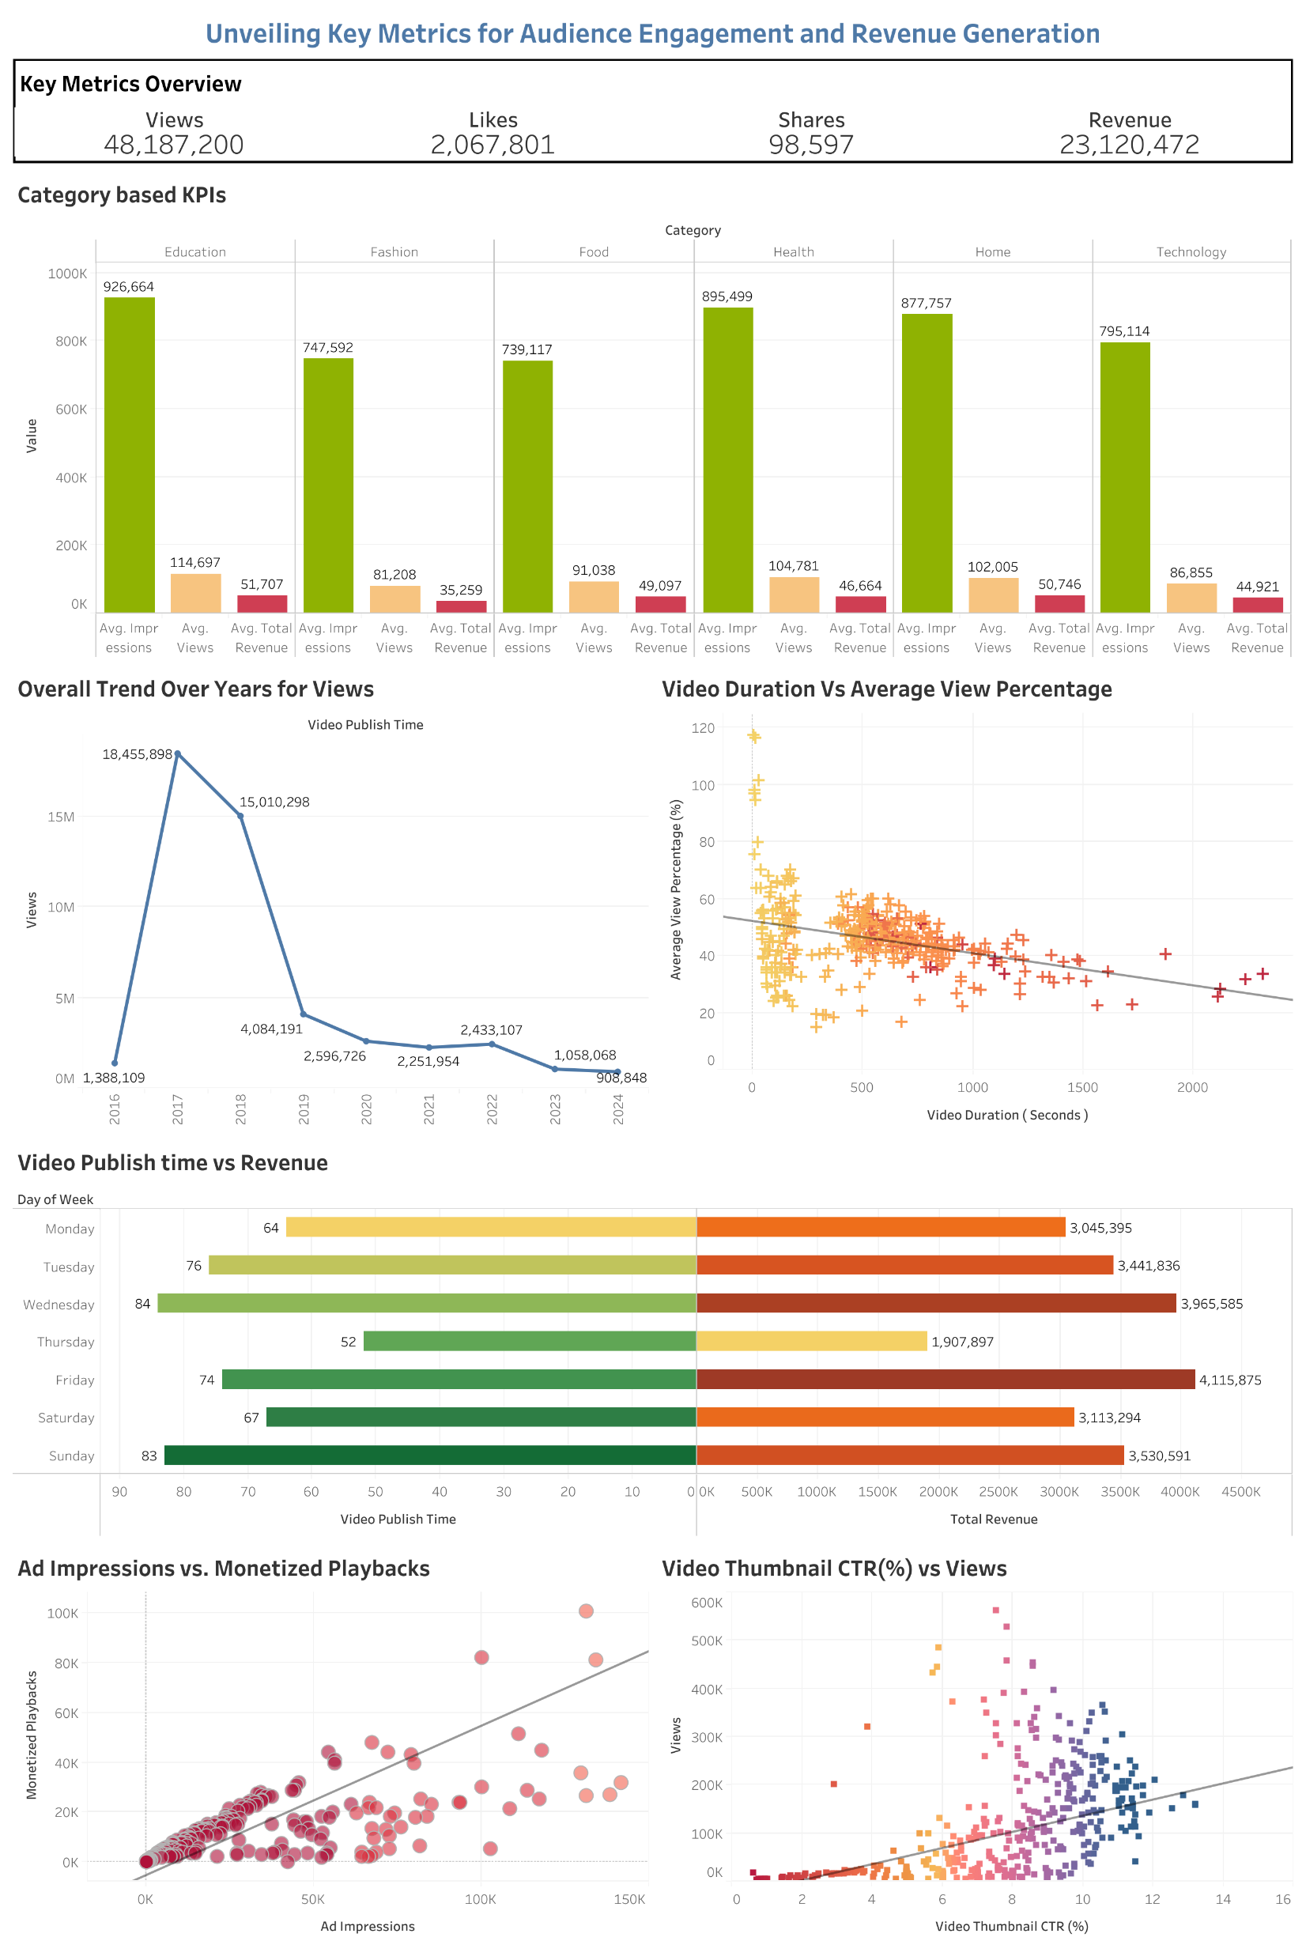
Demo time for our tableau dashboard…

Slide 14

conclusion
Key Findings:
Categories such as Education and Health outperform others.
Viewer retention vs. shorter video lengths.
Visually appealing thumbnails increases lick-through rates.
Growth trend over time.
Maximum engagement and revenue for videos posted on Fridays and Tuesdays.
Strong positive correlation between ad impressions and revenue.

Slide 15
Thanks for WATCHING

